Slide 1
Image Classifier to distinguish Vegetables using Deep Learning (LIVE)
Sufyan, DSI27

Slide 2
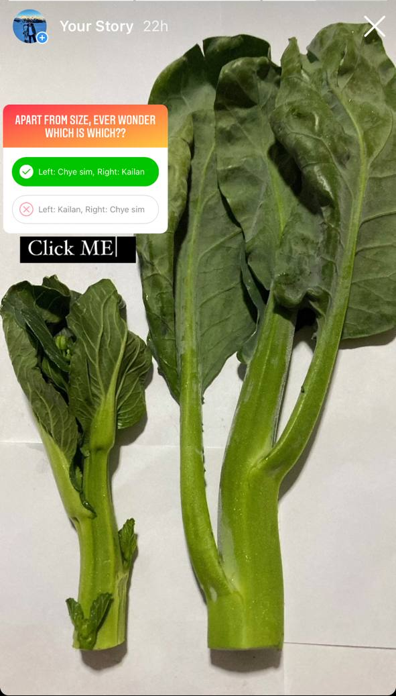
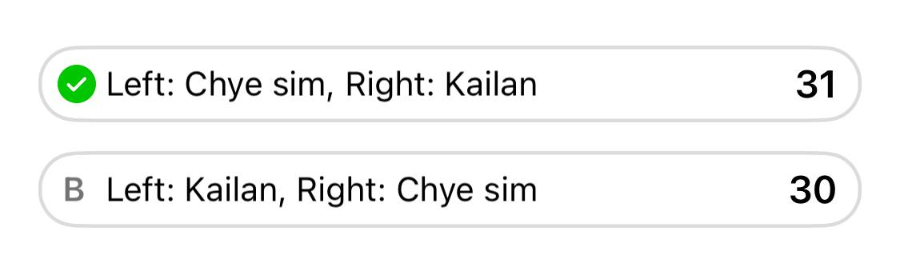
Why vegetables?
Unlabeled food that is hard to distinguish
Many still do not know how to differentiate vegetables
Image upload - Add-on for delivery services
Instead of figuring out what to search, use the camera instead
Auto-pricing mechanism
Price can be tagged by image of the type of vegetable
Notes:
Why specifically vegetables?
- Wanted to explore using image classifier on unlabelled food. Hence leafy vegetables, because I personally had issues going to the market buying vegetables that were unlabelled.
Googling names and referencing to pictures is easy. But looking at the vegetable and telling the name of it is difficult. Especially tricky ones like Kailan and Chyesim.
Did a poll → half of the participants guessed the vegetable wrong. So that’s where I see value in my project
Add on delivery services
Auto pricing mechanism – Maybe for NTUC where price can be tagged by image

Slide 3
Exploring Dataset

Slide 4
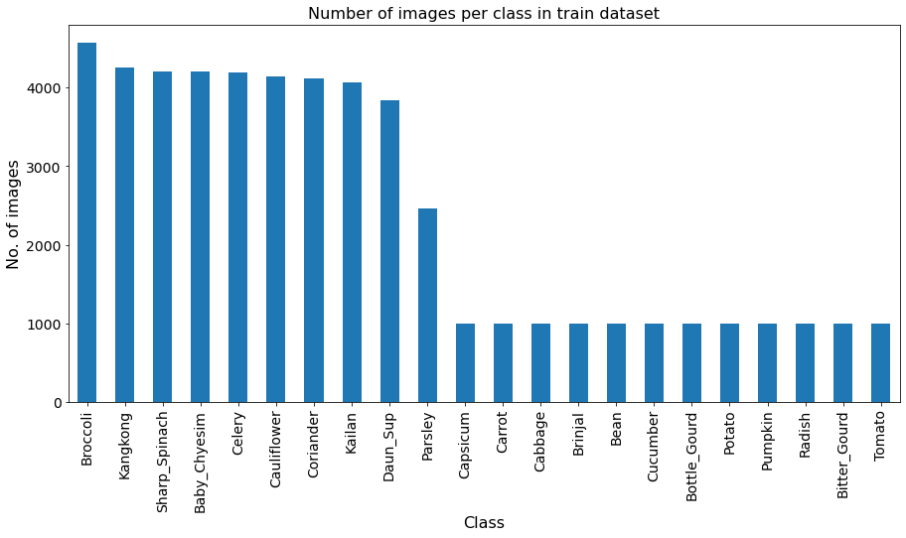
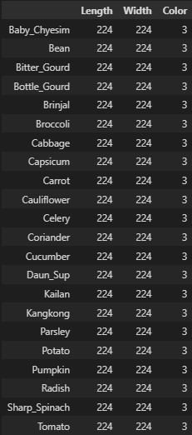
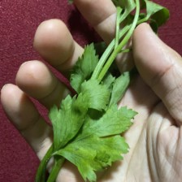
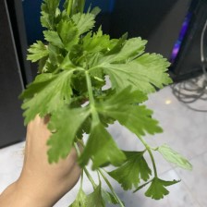
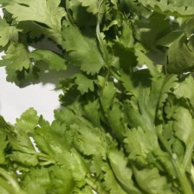
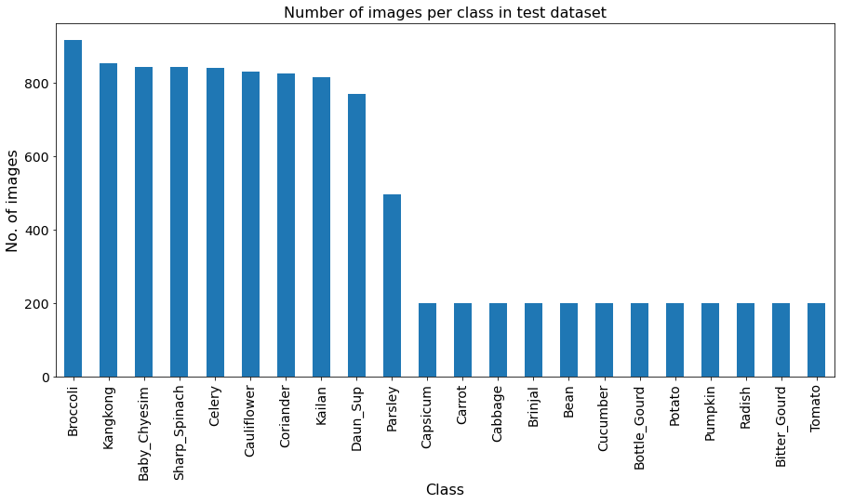
Data Pre-processing
Image Sizes
Parsley
Daun_sup
Coriander
Image size: (224,224,3)
Dataset made of
Kaggle dataset
Self-taken to better distinguish difficult vegetables

Slide 5
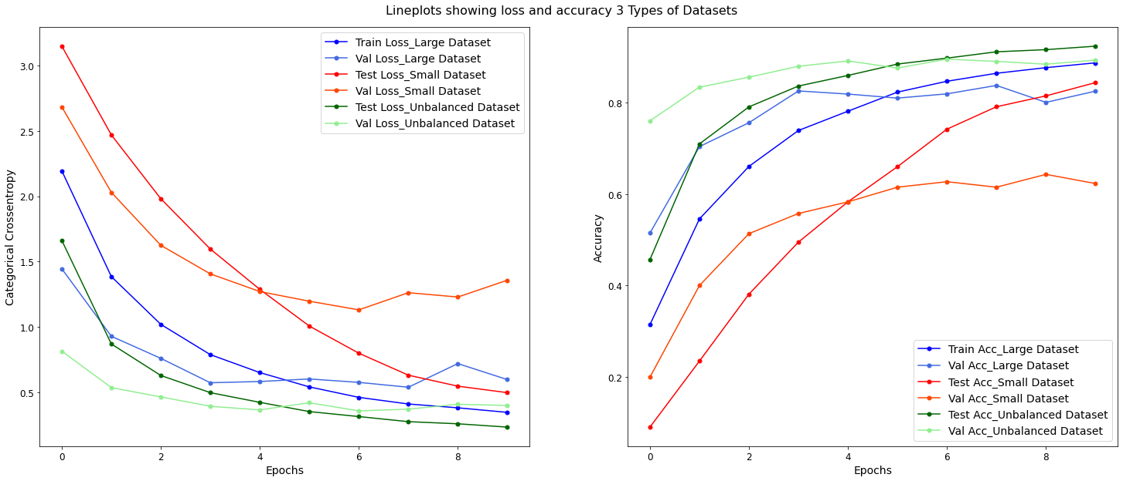
Large dataset = Accuracy ?
Criteria kept constant
Ratio between train and validation is the same
Size standardized to 224
Simple model used will be the same.
No augmentation
No preprocessing
The neural network is as good as it gets!!

Slide 6
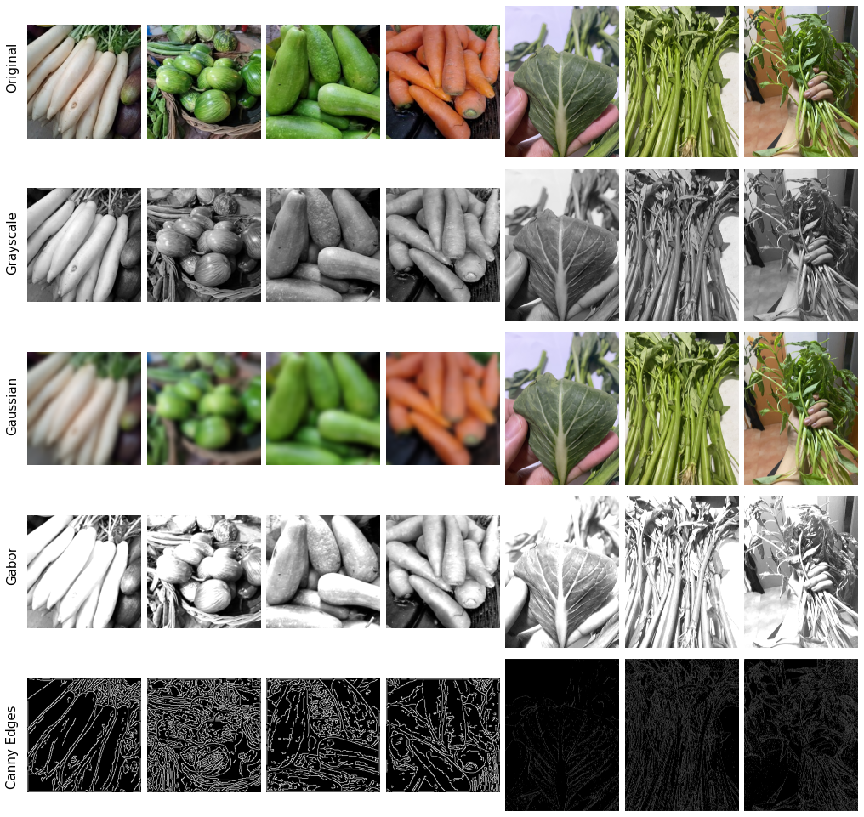

Feature extraction
Key observations and takeaways
Colored images
Texture | Leaf Venations
Blurring (Gaussian)
We might need blurred images to cater to camera input generating good predictions as models able to generalize to unseen data.
Grayscale
Can’t differentiate between carrot and radish
Edges
Cannot be used too as some vegetables have similar shapes

Slide 7
CNN Modelling

Slide 8

Basics of CNN in Deep learning
Source: Medium.com
Notes:
We use CNN for images because of its high accuracy.
From an input image, it goes through convolution layers,
A convolution is a type of matrix operation, consisting of a kernel, a small matrix of weights, that slides over input data performing element-wise multiplication, then adds the results into an output, creating activation maps that highlight features.
Initial layers tend to detect low-level features like lines while high-level features will detect (faces/shapes/specific objects).
There is ReLU activation function after these convolution layers is to increase the non-linearity in our images.
This means it will help remove all the negative values by setting it to zero hence not activating the neuron and turning it black.
Only those above 0 will be returned the same value.
Pooling layer helps to identify strong features and reduce the size of the feature maps.
Followed by Flattening (making data to 1-dimensional array) and
fully connected layers linking from one neuron to every neuron in other layer.
The feature vectors from the fully connected layers are used to classify images into distinct categories.
We use an activation function like softmax to give us the normalized probability across multi-classes.

Slide 9
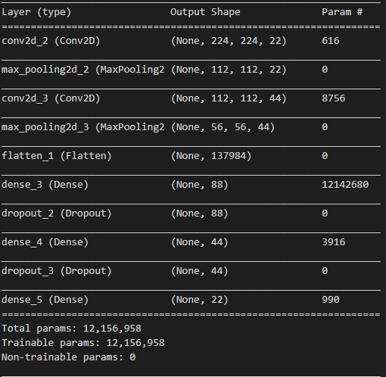
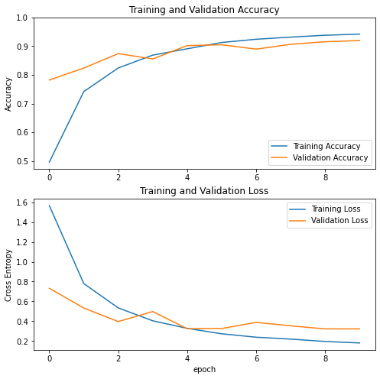
Initial CNN modelling – Base model
Overfitting observed!
1st Convolution Block
2nd Convolution Block
Flatten
2 layers of Fully connected network
Prediction layer
Train accuracy: 87%
Val accuracy: 85%
Notes:
Basic CNN model was made
Following the flow chart I showed earlier, did 2 convolution layers with max pooling, and flatter and 2 dense layers of fully connected layers, followed by softmax function with 22 classes.
Dense Layer is simple layer of neurons in which each neuron receives input from all the neurons of previous layer, thus called as dense. A dense Layer is used to classify images based on output from convolutional layers.

Slide 10
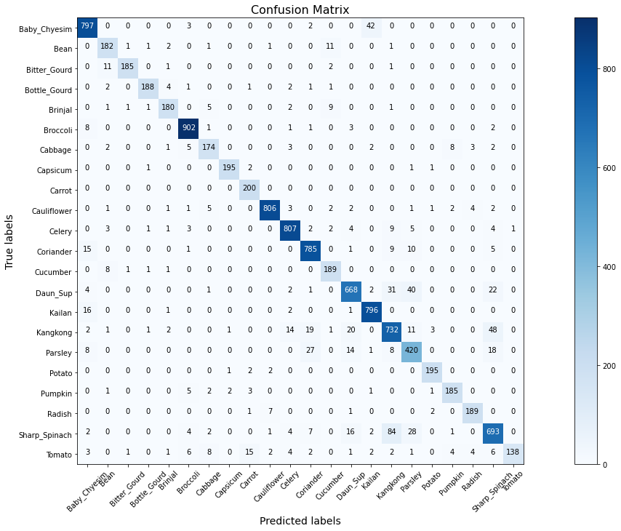
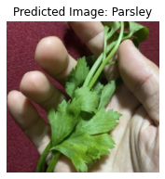
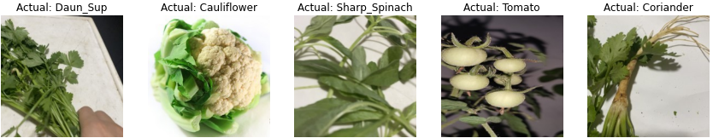
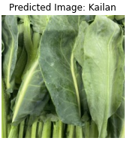
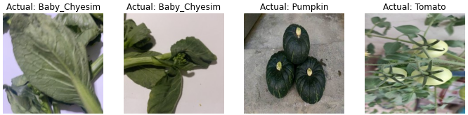
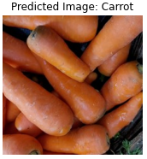
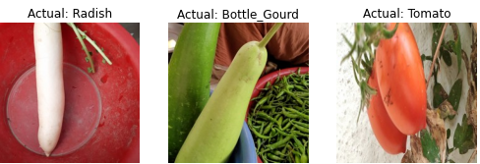
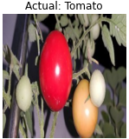
Base Model – Error Analysis
Misclassification of images
Predicted
Actual Image

Slide 11
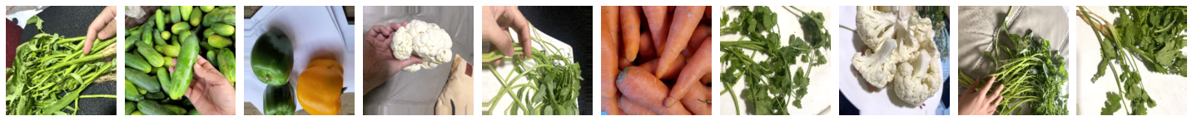
Data Augmentation
Using ImageDataGenerator
A non-additive approach to randomly transform images
Trains model with mini-batches of 32.
Augmentation done
Horizontal-flip
Vertical-flip
Shear-range = 20
Brightness range: 0.6 – 1.2

Slide 12
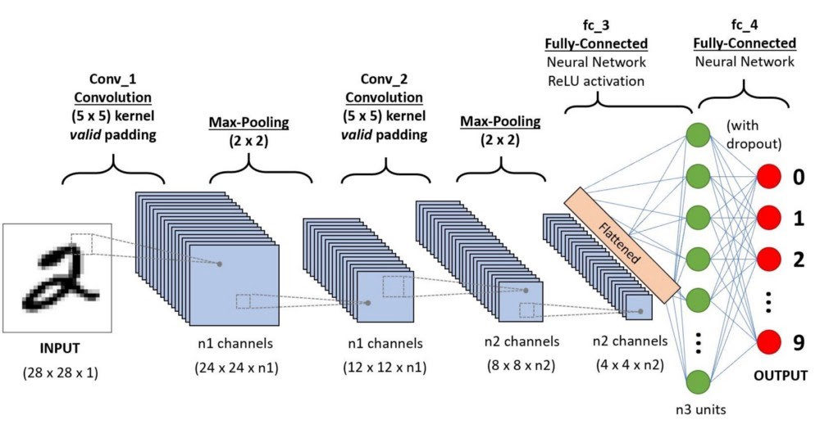
Worth building your own?
Self made Model
Building models from scratch takes a long time to optimize it
Not able to give any better results without exponentially increasing training time
Notes:
The model is trained on a small dataset, hence weights might not be optimized with limited amount of training time.

Slide 13
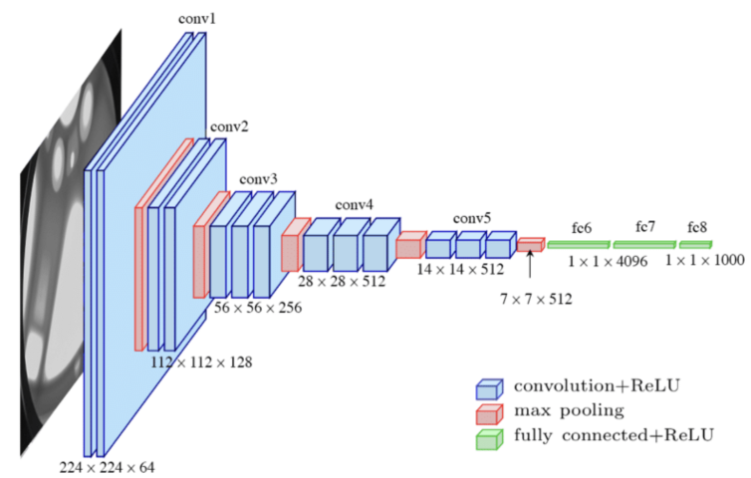
Why transfer learning?
VGG16
Pre-trained on millions of images from Imagenet.
We can use their weights and established architecture and apply the learning to our problem statement
Can further fine-tune to existing data-set
Notes:
The model is trained on a small dataset, hence weights might not be optimized with limited amount of training time.
Generally for VGG16, it consists of 5 blocks of convolutions with max pooling, from bigger dimension taking tensor of size 224,224. → 2 fully connected layers → prediction for 1000 classes.

Slide 14
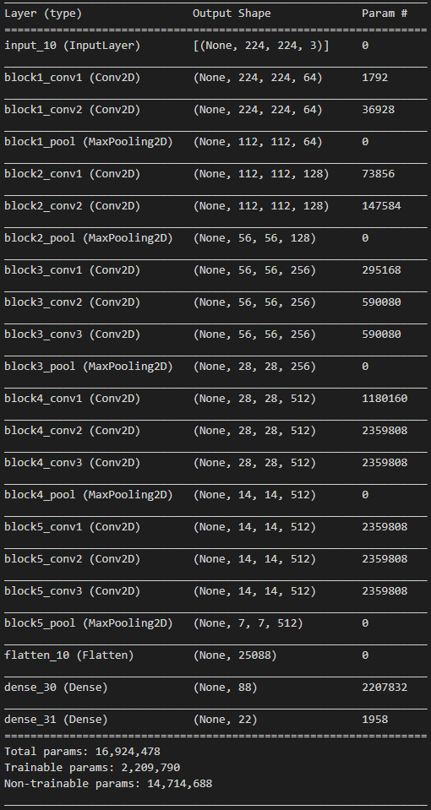
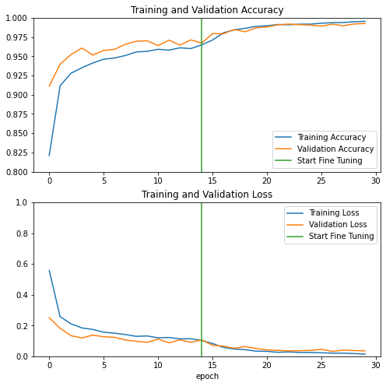
VGG16
1st Convolution Block
2nd Convolution Block
Frozen blocks with pre-trained weights
Steep learning curve
3rd Convolution Block
VGG 16 Base model
4th Convolution Block
5th Convolution Block
Fine-tuning: Unfreeze last block
15 epochs
15 epochs
Train acc: 96%
Val Acc: 96%
Train acc: 99.5%
Val Acc: 99.2%
Flatten
VGG16
1 layer Fully connected network
Optimize top layer
Prediction layer
Notes:
Fine-tuning after15 epochs
Unfreeze the top few layers for the model to be trained on, so that the fully connected layers would be more customized to the new dataset
A smaller learning rate used for fine-tuning allows the model to learn a more optimal set of weights when backpropagating.

Slide 15
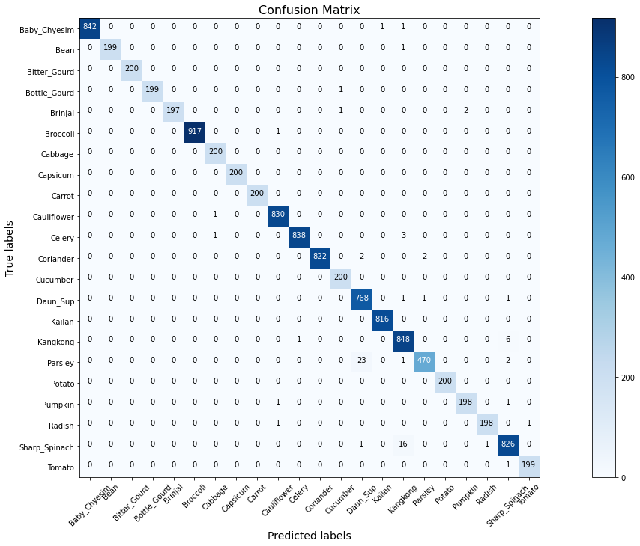
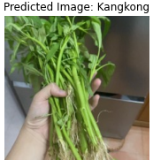
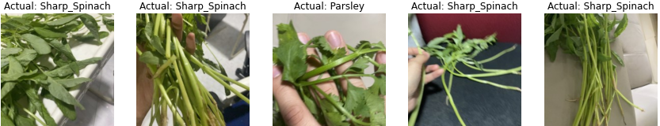
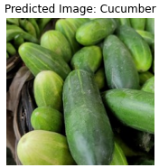
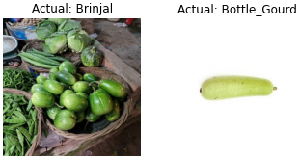
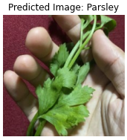
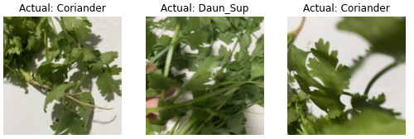
VGG16 – Error Analysis
Misclassification of images
Predicted
Actual Image

Slide 16
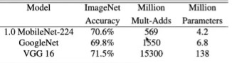
MobileNetV2
Known to have high accuracy while keeping parameters and operations very low
Low memory requirement
Effective object detection and segmentation.
Notes:
I personally picked MobileNetV2 to explore more on the architecture. The architecture delivers high accuracy results while keeping the parameters and mathematical operations as low as possible to bring deep neural networks to mobile devices.
We want to pay attention to daily task that require little hardware support which can be easily trained on our computers. It achieves performance balance performance results and the implementation efficiency. It has low memory requirement for hardware conditions.
It is very effective feature extractor for object detection and segmentation. The challenge for this model is to study how this pre-trained model will perform for image classification, where it would not be entirely pixel by pixel detail extraction. Hence, we will expect to see some sort of behaviour when training the model later.

Slide 17
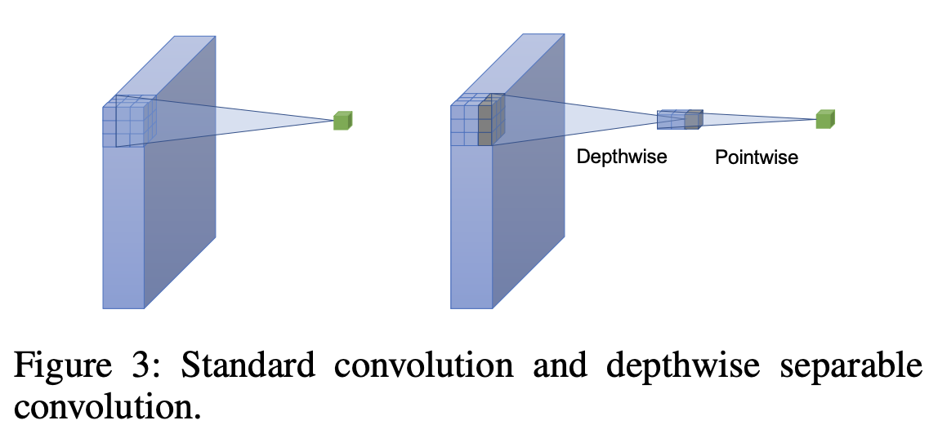
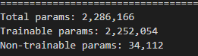
Architecture
Input image
224x224x3
Depth-wise separable convolution
Depth-wise: Apply to each filter by a single convolution layer per channel and stack them side by side separately.
Point-wise: Uses a 1x1 filter through all channel, and create a linear combination of the output of the depthwise convolution
Conv
Conv, 1x1, RelU6
112x112x32
Bottleneck 1
Depthwise Conv, 3x3, ReLU6
112x112x16
Residual (Shortcut)
Bottleneck Residual Block
Bottleneck 2
Conv, 1x1
Add
Bottleneck 16
7x7x320
Conv
Frozen
Decreases the number of computations hence highly efficient!
Unfrozen
1x1x1280
Fully connected layers
1x1x22
22 classes
Notes:
###
One distinct feature of mobilenetv2 is it uses depth-wise separable convolution. Different from regular convolution.
A Standard convolution which uses a kernel to do element-wise multiplication across ALL CHANNELS followed by the addition of the results into an output.
For depth wise separable it has two parts,
One of which is depth-wise convolution, like standard convolution, it applies a filter per channel and keeping output each channel separately.
Point-wise will then apply a 1x1 filter across the whole channel, just think of it as using a stick to poke thru the output layer from depthwise convolution, by doing a linear combination giving us one single output.
The difference, mathematically, is that it reduces the number of computations greatly, rendering this method highly efficient. Hence as you see the total params is only 2million as compared to VGG16 with 16mill params.
###
1
2) Inverted residual
- Residual Connections are a type of skip-connection that learn residual functions with reference to the layer inputs, instead of learning unreferenced functions.
- The idea of inverted residual is taking the narrow layers as the input going through (narrow-wide-narrow concept) rather than taking input from the bigger layer first.
- in this case we have the expansion layer by using 1x1 filter
- followed by projection layer to reduce to the same dimension as the input layer → to do linear combinations
3) Linear bottleneck
- Typically, we use non-linear activation functions like ReLU to discard values lower than 0, as multiple matrix multiplication cannot be reduced to a single numerical operation.
- Because we are using inverted residual, our tensors are very low in dimension where the skip connections are linked, hence using a non-linear will hurt the performance of the network leaving out crucial information.

Slide 18
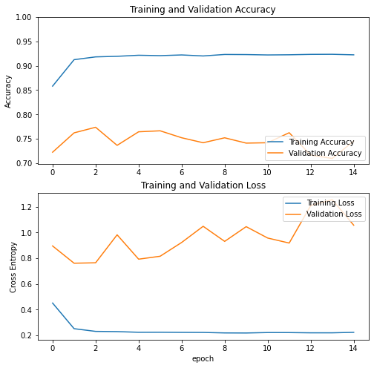
Mobile NET V2 – Validation loss freeze
Transfer learning:
Changed output layer to classify to 22 classes
Architecture remains the same
Layers were frozen
Stagnant ~ 0.75%
Not OVERFITTING!
High validation loss
Not Dataset problem
Pre-trained weights?
MobileNetV2 – Pre-trained model with existing weights

Slide 19
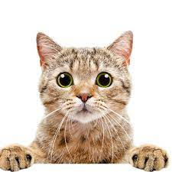

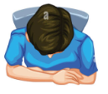
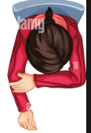
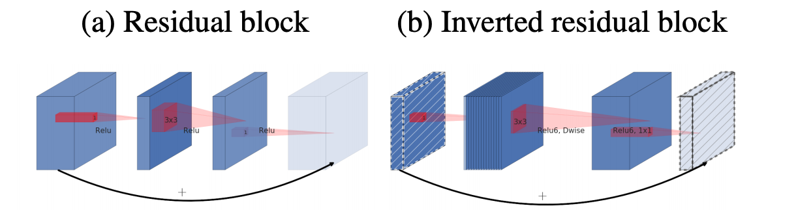

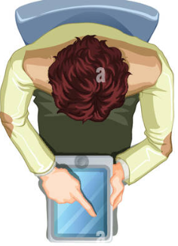

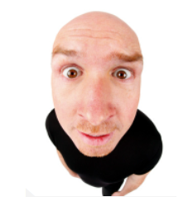
Architecture
Input image
224x224x3
Inverted Residual
Residual connection acts as a shortcut for the network to easily learn identity-like mappings
Inverted means starting from a thin layer (bottleneck)
(narrow → wide → narrow concept)
x
Conv
Conv, 1x1, RelU6
112x112x32
Bottleneck 1
Depthwise Conv, 3x3, ReLU6
F
112x112x16
Residual (Shortcut)
Bottleneck Residual Block
Bottleneck 2
Conv, 1x1
F(x)
x
Add
Bottleneck 16
F(x) + x
7x7x320
Conv
Frozen
Unfrozen
1x1x1280
Fully connected layers
1x1x22
22 classes
Notes:
Previously we have frozen pre-trained weights in the convolution layers. MobileNetV2 has these features called inverted residuals.
Think of residual as a short-cut for the network to easily learn identity-like mappings just like giving you a set of answers to copy from. The word inverted was used because it is using the idea of (narrow → wide → narrow concept).
So if in the first place we have only one first full convolution layer followed by a series of thin bottleneck layers, if the first convolution was not able to extract enough crucial features from the beginning, the subsequent hidden convolution layers will not be able to extract out accurate critical features that can help with better classify them.
Hence, initializing its weights from the beginning might help in giving the model more information to work on and backpropagate down the layers with more valuable features.

Slide 20
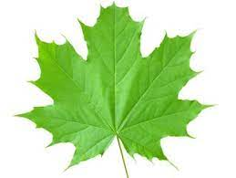
Architecture
Input image
224x224x3
Inverted Residual
Residual connection acts as a shortcut for the network to easily learn identity-like mappings
Inverted means starting from a thin layer (bottleneck)
(narrow → wide → narrow concept)
x
Conv
Conv, 1x1, RelU6
112x112x32
Bottleneck 1
Depthwise Conv, 3x3, ReLU6
F
112x112x16
Residual (Shortcut)
Bottleneck Residual Block
Bottleneck 2
Conv, 1x1
F(x)
x
Add
Bottleneck 16
F(x) + x
7x7x320
Conv
Frozen
Unfrozen
1x1x1280
Fully connected layers
??
1x1x22
22 classes
Notes:
Previously we have frozen pre-trained weights in the convolution layers. MobileNetV2 has these features called inverted residuals.
Think of residual as a short-cut for the network to easily learn identity-like mappings just like giving you a set of answers to copy from. The word inverted was used because it is using the idea of (narrow → wide → narrow concept).
So if in the first place we have only one first full convolution layer followed by a series of thin bottleneck layers, if the first convolution was not able to extract enough crucial features from the beginning, the subsequent hidden convolution layers will not be able to extract out accurate critical features that can help with better classify them.
Hence, initializing its weights from the beginning might help in giving the model more information to work on and backpropagate down the layers with more valuable features.

Slide 21
Architecture
Input image
224x224x3
Inverted Residual
Residual connection acts as a shortcut for the network to easily learn identity-like mappings
Inverted means starting from a thin layer (bottleneck)
(narrow → wide → narrow concept)
x
Conv
Conv, 1x1, RelU6
112x112x32
Bottleneck 1
Depthwise Conv, 3x3, ReLU6
F
112x112x16
Residual (Shortcut)
Bottleneck Residual Block
Bottleneck 2
Frozen pre-trained weights learnt from images from ImageNet
Conv, 1x1
F(x)
x
Add
Bottleneck 16
F(x) + x
7x7x320
Conv
Frozen
Unfrozen
1x1x1280
Fully connected layers
1x1x22
22 classes
Notes:
Previously we have frozen pre-trained weights in the convolution layers. MobileNetV2 has these features called inverted residuals.
Think of residual as a short-cut for the network to easily learn identity-like mappings just like giving you a set of answers to copy from. The word inverted was used because it is using the idea of (narrow → wide → narrow concept).
So if in the first place we have only one first full convolution layer followed by a series of thin bottleneck layers, if the first convolution was not able to extract enough crucial features from the beginning, the subsequent hidden convolution layers will not be able to extract out accurate critical features that can help with better classify them.
Hence, initializing its weights from the beginning might help in giving the model more information to work on and backpropagate down the layers with more valuable features.

Slide 22
Architecture
Input image
224x224x3
Inverted Residual
Residual connection acts as a shortcut for the network to easily learn identity-like mappings
Inverted means starting from a thin layer (bottleneck)
(narrow → wide → narrow concept)
x
Conv
Conv, 1x1, RelU6
112x112x32
Bottleneck 1
Depthwise Conv, 3x3, ReLU6
F
112x112x16
Residual (Shortcut)
Bottleneck Residual Block
Bottleneck 2
Conv, 1x1
F(x)
Unfreeze and retrain
x
Add
Bottleneck 16
F(x) + x
7x7x320
Conv
1x1x1280
Fully connected layers
1x1x22
22 classes
Notes:
Previously we have frozen pre-trained weights in the convolution layers. MobileNetV2 has these features called inverted residuals.
Think of residual as a short-cut for the network to easily learn identity-like mappings just like giving you a set of answers to copy from. The word inverted was used because it is using the idea of (narrow → wide → narrow concept).
So if in the first place we have only one first full convolution layer followed by a series of thin bottleneck layers, if the first convolution was not able to extract enough crucial features from the beginning, the subsequent hidden convolution layers will not be able to extract out accurate critical features that can help with better classify them.
Hence, initializing its weights from the beginning might help in giving the model more information to work on and backpropagate down the layers with more valuable features.

Slide 23
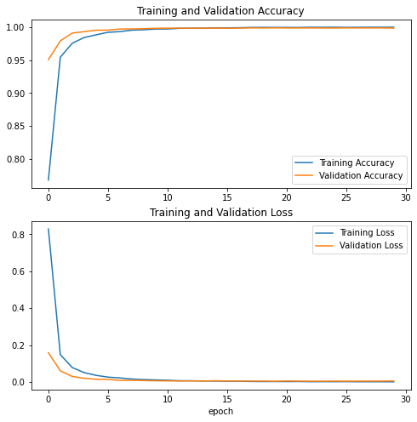
Mobile NET V2 – Unfreeze and re-train
Steps taken:
Unfreeze all layers except BN
Re-train model with RMS prop and smaller learning rate
Train acc: 99.8%
Val Acc: 99.8%
MobileNetV2 – Unfrozen and re-trained

Slide 24

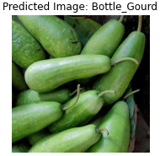
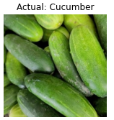
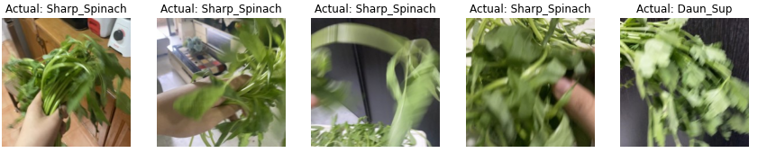
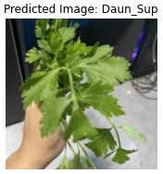
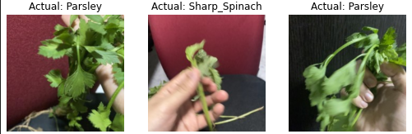
MobileNetV2
Misclassification of images
Predicted
Actual Image

Slide 25
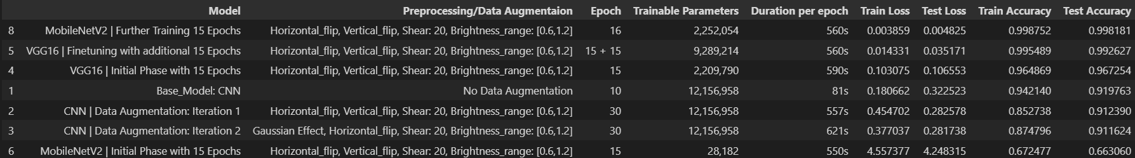
Summary Score Table
MobileNetV2 has the highest score of 0.998 as compared to VGG16 after fine-tuning.
Production Model: MobileNetV2 (low-cost operation and good prediction)
Base model
VGG16 Model
MobileNetV2 Model
Notes:
MobilenetV2 has the highest test score of 0.998 as compared to VGG16.
One `adverse` impact of using VGG16 is that we will need **huge amount of disk space** and bandwidth that makes it efficient whereas MobileNetV2 gives good predictions while running at a low-cost operations which is good for mobile devices.
**Thus, I will choose MobileNetV2 as my production model**

Slide 26
Feature maps
Comparison between
MobileNetV2_Pre-trained weight Model
Vs
MobileNetV2_Unfrozen and re-trained Model

Slide 27



Feature maps: Coriander
MobileNetV2_Pre-trained weights
MobileNetV2_Unfrozen and Fully re-trained
MobileNetV2_Pre-trained weights
Features defined better
MobileNetV2_ Unfrozen and Fully retrained

Slide 28
Image Upload
Unseen data

Slide 29








Unseen data: Make a guess?
CNN Model
VGG16 Model
MobileNetV2 Model

Slide 30




Unseen data: Make a guess?
CNN Model
VGG16 Model
MobileNetV2 Model
CNN Model
VGG16 Model
MobileNetV2 Model

Slide 31
Live Webcam
Unseen data

Slide 32

Baby Chyesim Vs Kailan
Baby Chyesim
Kailan
Baby Chyesim
Kailan

Slide 33

Baby Chyesim Vs Kailan

Slide 34
Recommendations
Unseen data

Slide 35
Key takeways
Train with a clearer dataset
Not all transfer learning models are good for our specific use case
Considering MobileNetV2 for its low memory usage for phones
U-net is most prominent in the medical field. Designed for semantic segmentation
Things to improve
Use Fixed ROI – Image reduced only to the area relevant for prediction
Notes:
To have a good image classifier, it is very crucial we do proper data cleaning, including taking the right photos and ensuring only features of the vegetables and do not introduce too much variables that may seem important to the model, for example including too much of the hand while taking the photos. In global context, when we are dealing with image gathering through cloud or online spaces, we have to be mindful of filtering away pictures that has incriminating features like the label names it self,ie. taking pictures of cabbages with the background indicating labels: 'Cabbage'.
Also, retraining models may consist a few iterations. It helps when we better understand the model we pick for transfer learning as not all models are good for our specific use cases, like vegetables. We may need look at the pre-trained images used for the model, and understand the features captured. We also have to consider the memory usage if we are thinking of using these models in our phones.
U-net is designed for semantic segmentation. Something like object detection, instead of using boxes to identify a person, semantic segmentation will colour pixels either to cell or not cell (background). Instance segmentation → extension of semantic and split into different cells.

Slide 36
Recommendations
Assuming deployment using Live Video, we can put more effort into expanding the dataset with cleaner pictures from cloud spaces
To cater for wrongly classified images or missing classes;
Deploying an option for users to input simple feedback if they don’t think that the top predicted image matches the unseen data
Video to autosave and used as input file to learn new data by frames
Zoom into classes that has lower defining probabilities between Top and 2nd predictions.
(50% - Top prediction, 40% - 2nd prediction)
Notes:
To have a good image classifier, it is very crucial we do proper data cleaning, including taking the right photos and ensuring only features of the vegetables and do not introduce too much variables that may seem important to the model, for example including too much of the hand while taking the photos. In global context, when we are dealing with image gathering through cloud or online spaces, we have to be mindful of filtering away pictures that has incriminating features like the label names it self,ie. taking pictures of cabbages with the background indicating labels: 'Cabbage'.
Also, retraining models may consist a few iterations. It helps when we better understand the model we pick for transfer learning as not all models are good for our specific use cases, like vegetables. We may need look at the pre-trained images used for the model, and understand the features captured. We also have to consider the memory usage if we are thinking of using these models in our phones.
U-net is designed for semantic segmentation. Something like object detection, instead of using boxes to identify a person, semantic segmentation will colour pixels either to cell or not cell (background). Instance segmentation → extension of semantic and split into different cells.

Slide 37
Thank you!

Slide 38
Additional Slides

Slide 39

Architecture
MobileNetV2 Structure
Notes:
**3 Main Features**
1) Depthwise separable convolution
- Depthwise Convolution: Performs lightweight filtering by applying a single convolutional filter per input channel. Channel-wise operations
- Pointwise Convolution: Uses 1x1 convolution, uses pixel wise, to help build new features through computing linear combinations of the input channels. This kernel has a depth based on how many channels the input image has.
2) Inverted residual
- Residual Connections are a type of skip-connection that learn residual functions with reference to the layer inputs, instead of learning unreferenced functions.
- The idea of inverted residual is taking the narrow layers as the input going through (narrow-wide-narrow concept) rather than taking input from the bigger layer first.
- in this case we have the expansion layer by using 1x1 filter
- followed by projection layer to reduce to the same dimension as the input layer → to do linear combinations
3) Linear bottleneck
- Typically, we use non-linear activation functions like ReLU to discard values lower than 0, as multiple matrix multiplication cannot be reduced to a single numerical operation.
- Because we are using inverted residual, our tensors are very low in dimension where the skip connections are linked, hence using a non-linear will hurt the performance of the network leaving out crucial information.

Slide 40


Main features
Inverted Residual
What is residual? → Skip function that learns residual functions with reference to the input layer.
The idea of inverted is taking in narrow layers as the input, then expanding and narrowing again before entering another layer.
(narrow → wide → narrow concept)
Linear bottleneck (Memory-efficient inference)
Tensors are very low in dimension where skip connections are linked, if we use a non-linear function, will hurt the performance of the network.
Non – linear function
Notes:
**3 Main Features**
1) Depthwise separable convolution
- Depthwise Convolution: Performs lightweight filtering by applying a single convolutional filter per input channel. Channel-wise operations
- Pointwise Convolution: Uses 1x1 convolution, uses pixel wise, to help build new features through computing linear combinations of the input channels. This kernel has a depth based on how many channels the input image has.
2) Inverted residual
- Residual Connections are a type of skip-connection that learn residual functions with reference to the layer inputs, instead of learning unreferenced functions.
- The idea of inverted residual is taking the narrow layers as the input going through (narrow-wide-narrow concept) rather than taking input from the bigger layer first.
- in this case we have the expansion layer by using 1x1 filter
- followed by projection layer to reduce to the same dimension as the input layer → to do linear combinations
3) Linear bottleneck
- Typically, we use non-linear activation functions like ReLU to discard values lower than 0, as multiple matrix multiplication cannot be reduced to a single numerical operation.
- Because we are using inverted residual, our tensors are very low in dimension where the skip connections are linked, hence using a non-linear will hurt the performance of the network leaving out crucial information.

Slide 41






Feature maps: Kailan
Input layer
Convolution layer
Expanded depth-wise conv ReLU
-
-
-
Block 1 – Depth-wise ReLU
Block 6 – Depth-wise ReLU

